Slide 1
TEAM 21 COLLEGE & CAREER WEEKS
Interview Attire and Tips

Slide 2
Interview Video
https://www.youtube.com/watch?v=GmzYrjAsDng
http://video.about.com/jobsearch/Job-Interview-Tips-for-Teens.htm

Slide 3
Proper Attire, Yes or No? Why?

Slide 4
Proper Attire, Yes or No? Why?

Slide 5
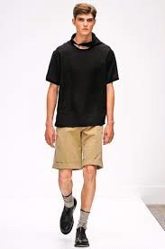
Proper Attire, Yes or No? Why?

Slide 6
Proper Attire, Yes or No? Why?

Slide 7
Proper Attire, Yes or No? Why?

Slide 8
Proper Attire, Yes or No? Why?

Slide 9
Proper Attire, Yes or No? Why?

Slide 11
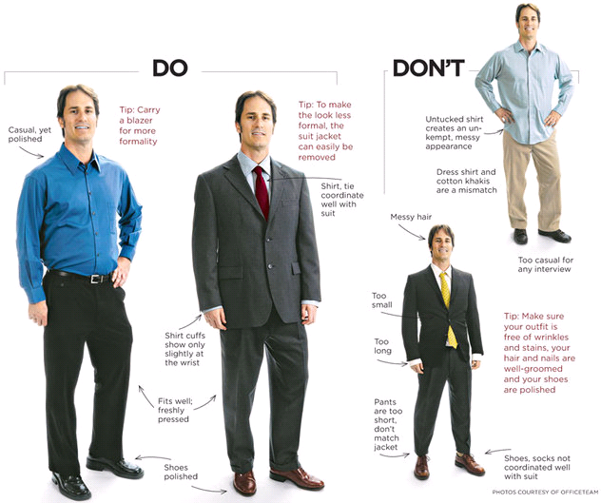

Slide 12
Appropriate Attire

Slide 13
Interview Tips
Research & Prepare
Social Media (appropriate)
Dress for success
Turn off your phone
Firm Handshake, Thank them
Good Eye Contact
Be attentive, listen.
Ask Questions

Slide 14
More Interview Tips
Do not make jokes
Answer questions concisely & honestly-do not give long winded answers or lie
Do not badmouth old bosses
Do not play with your face or hair
Have career goals
Be prepared to talk about your success’ and accomplishments
Ask questions

Slide 15
Great Responses to Interview Questions
“I am a team player” or “I work well with others”
“I am self motivated and a hard worker”
“I am very passionate about my work”
“I am creative and good at solving problems”
“I go above and beyond in everything that I do”

Slide 16
Interview Questions
What makes you the best qualified person for this job?
What work experience do you have?
Why do you want this job?
Do you have any special skills/talents?

Slide 17
Interview DON’T

Slide 18
Interview DON’T

Slide 19
Interview DON’T

